Slide 1
Chapter 21 Concurrency Control Techniques

Slide 2
- Introduction - Two-Phase Locking Technique for Concurrency Control - Time stamping
Content

Slide 3
Introduction
Different protocols can be used to ensure serializability in schedules
DBMS uses some set of protocols to ensure concurrent execution of transactions
One important set of protocols two-phase locking protocols
employs the technique of locking data items to prevent multiple transactions from accessing the items concurrently.
Another set of concurrency control protocols uses timestamps.
A timestamp is a unique identifier for each transaction, generated by the system.
Timestamp are generated in order with the execution of transactions

Slide 4
Two-Phase Locking Techniques for Concurrency Control
Lock:
a variable associated with a data item that describes the status of the item with respect to possible operations that can be applied to it.
Generally, one data time has one lock in the database.
Used for synchronizing the access by concurrent transactions to the database items.
Now we will discuss:
Type of locks
How to ensure serializability with locking protocols
Problems with locks
Deadlock
starvation

Slide 5
Two-Phase Locking Techniques for Concurrency Control
Types of Locks and System Lock Tables
There are 3 types of locks:
Binary locks
Shared/exclusive locks
Certify lock

Slide 6
Two-Phase Locking Techniques for Concurrency Control
Types of Locks and System Lock Tables
Binary Locks:
Most simple type of locks
Not frequently used as they are too restrictive for database concurrency control.
A unique lock is associated with each database item X.
A binary lock can have two states or values:
locked (value= 1)
unlocked (value= 0)
Two operations can be performed on binary locks,
lock_item
unlock_item.

Slide 7
Two-Phase Locking Techniques for Concurrency Control
Types of Locks and System Lock Tables
Binary Locks:
If the value of the lock on X is 1,
item X cannot be accessed by a database operation that requests the item.
If the value of the lock on X is 0,
the item X can be accessed when requested, and the lock value is changed to 1.
A transaction requests access to an item X by first issuing a lock_item(X) operation.
If LOCK(X) = 1, the transaction is forced to wait.
If LOCK(X) = 0, it is set to 1 (the transaction locks the item) and the transaction is allowed to access item X.
When the transaction is done using the item, it issues an unlock_item(X) operation, which sets LOCK(X) back to 0 so that X may be accessed by other transactions.

Slide 8
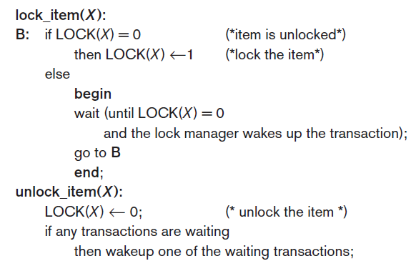
Two-Phase Locking Techniques for Concurrency Control
Types of Locks and System Lock Tables
Binary Locks:

Slide 9
Two-Phase Locking Techniques for Concurrency Control
Types of Locks and System Lock Tables
Binary Locks:
The wait command within the lock_item(X) operation is usually implemented by putting the transaction in a waiting queue for item X until X is unlocked, and the transaction can be granted access to it.
Other transactions that also want to access X are placed in the same queue.

Slide 10
Two-Phase Locking Techniques for Concurrency Control
Types of Locks and System Lock Tables
Binary Locks.
It is simple to implement a binary lock; all that is needed is a binary-valued variable, LOCK, associated with each data item X in the database.
The lock manager subsystem in DBMS keep track of and control access to locks.
Lock table contain the locks
Each lock can be a record with three fields: <Data_item_name, LOCK, Locking_transaction> And a queue for transactions that are waiting to access the item.
The system needs to maintain only these records for the items that are currently locked in a lock table.
Items not in the lock table are unlocked.

Slide 11
Two-Phase Locking Techniques for Concurrency Control
Types of Locks and System Lock Tables
Binary Locks.
For binary locking, every transaction must obey the following rules:
A transaction T must issue the operation lock_item(X) before any read_item(X) or write_item(X) operations are performed in T.
A transaction T must issue the operation unlock_item(X) after all read_item(X) and write_item(X) operations are completed in T.
A transaction T will not issue a lock_item(X) operation if it already holds the lock on item X.
A transaction T will not issue an unlock_item(X) operation unless it already holds the lock on item X.

Slide 12
Two-Phase Locking Techniques for Concurrency Control
Types of Locks and System Lock Tables
Binary Locks:
Between the lock_item(X) and unlock_item(X) operations in transaction T, T is said to hold the lock on item X.
At most one transaction can hold the lock on a particular item.
Thus, no two transactions can access the same item concurrently.

Slide 13
Two-Phase Locking Techniques for Concurrency Control
Types of Locks and System Lock Tables
Binary Locks:
Problem:
Binary locking scheme is too restrictive for database items because at most one transaction can hold a lock on a given item.
Neither read nor write operation is allowed by any two transactions at the same time

Slide 14
Two-Phase Locking Techniques for Concurrency Control
Types of Locks and System Lock Tables
Shared/Exclusive (or Read/Write) Locks:
Allow several transactions to access the same item X if they all access X for reading purposes only.
As two Read operations at same item are not conflicting
But for write operation, it must have exclusive access for the data item.

Slide 15
Two-Phase Locking Techniques for Concurrency Control
Types of Locks and System Lock Tables
Shared/Exclusive (or Read/Write) Locks:
A multiple-mode lock is used in this scheme.
There are three locking operations:
read_lock(X), write_lock(X), and unlock(X).
LOCK(X) has 3 possible states:
read-locked, write-locked, or unlocked.

Slide 16
Two-Phase Locking Techniques for Concurrency Control
Types of Locks and System Lock Tables
Shared/Exclusive (or Read/Write) Locks:
A read-locked item:
also called share-locked
because other transactions are allowed to read the item,
A write-locked item:
also called exclusive-locked
because a single transaction exclusively holds the lock on the item.

Slide 17
Two-Phase Locking Techniques for Concurrency Control
Types of Locks and System Lock Tables
Shared/Exclusive (or Read/Write) Locks:
One method for implementing the operations on a read/write lock is:
to keep track of the number of transactions that hold a shared (read) lock on an item in the lock table
along with the list of transaction ids that hold a shared lock.
Each record in the lock table will have four fields: <Data_item_name, LOCK, No_of_reads, Locking_transaction(s)>.

Slide 18
Two-Phase Locking Techniques for Concurrency Control
Types of Locks and System Lock Tables
Shared/Exclusive (or Read/Write) Locks:
The state of LOCK is either read-locked or write-locked.
LOCK(X) = write-locked,
the value of locking transaction(s) is a single transaction that holds the exclusive (write) lock on X.
LOCK(X) = read-locked,
the value of locking transaction(s) is a list of one or more transactions that hold the shared (read) lock on X.

Slide 19
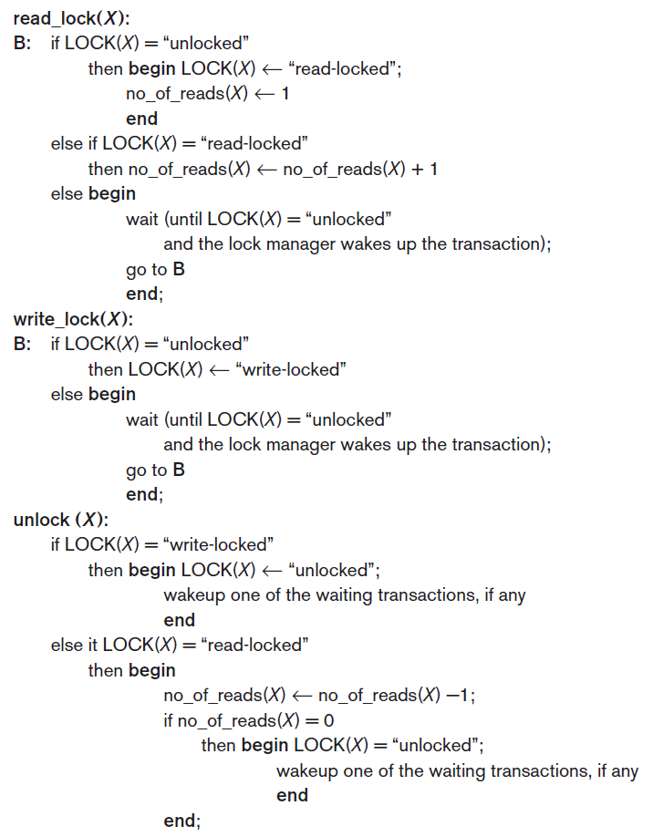
Two-Phase Locking Techniques for Concurrency Control
Types of Locks and System Lock Tables
Shared/Exclusive (or Read/Write) Locks.
Notes:
The first read on X
2nd condition is the 2nd or other read i.e. other item may be performing read
3rd condition is some one else is doing write on X so exclusive lock was placed on it wait till then

Slide 20
Two-Phase Locking Techniques for Concurrency Control
Types of Locks and System Lock Tables
Shared/Exclusive (or Read/Write) Locks.

Slide 21
Two-Phase Locking Techniques for Concurrency Control
Types of Locks and System Lock Tables
Shared/Exclusive (or Read/Write) Locks.
Notes:
Write lock just release locks
But read locks may have multiple items reading simultaneously so it’ll decrease reading count and if it’s the last reading item then release the lock

Slide 22
Two-Phase Locking Techniques for Concurrency Control
Types of Locks and System Lock Tables
Shared/Exclusive (or Read/Write) Locks.
When we use the shared/exclusive locking scheme, the system must enforce the following rules:
A transaction T must issue the operation read_lock(X) before any read_item(X) operation is performed in T.
i.e., Acquire lock first and then perform operation
A transaction T must issue the operation write_lock(X) before any write_item(X) operation is performed in T.
i.e., Acquire lock first and then perform operation
A transaction T must issue the operation unlock(X) after all read_item(X) or the write_item(X) operations are completed in T.

Slide 23
Two-Phase Locking Techniques for Concurrency Control
Types of Locks and System Lock Tables
Shared/Exclusive (or Read/Write) Locks.
When we use the shared/exclusive locking scheme, the system must enforce the following rules:
A transaction T will not issue a read_lock(X) operation if it already holds a read (shared) lock or a write (exclusive) lock on item X.
i.e, No two locks allowed at the same time on a data item
A transaction T will not issue a write_lock(X) operation if it already holds a read (shared) lock or write (exclusive) lock on item X.
A transaction T will not issue an unlock(X) operation unless it already holds a read (shared) lock or a write (exclusive) lock on item X.
i.e., T cannot unlock unless it has a acquired a lock

Slide 24
Two-Phase Locking Techniques for Concurrency Control
Types of Locks and System Lock Tables
Conversion (Upgrading, Downgrading) of Locks.
A transaction that already holds a lock on item X is allowed to convert the lock from one locked state to another.
Possible for a transaction T to issue a read_lock(X) and then later to upgrade the lock by issuing a write_lock(X).
If T is the only transaction holding a read lock on X at the time it issues the write_lock(X) operation, the lock can be upgraded;
otherwise, the transaction must wait.
Possible for a transaction T to issue a write_lock(X) and then later to downgrade the lock by issuing a read_lock(X).

Slide 25
Locking Techniques for Concurrency Control
Locking protocols
Locking protocols
Simple locking
Two phase locking
Basic 2PL
Conservative 2PL
Strict 2PL
Rigorous 2PL

Slide 26
Locking Techniques for Concurrency Control
Locking protocols
Simple locking:
A transaction is said to follow the Simple locking:
If it performs the read and write operations only after the lock acquisition
And release the lock once work is done
Now we will discuss two transactions that are executed concurrently after using simple locking protocol
Problem:
Simple locking doesn't always ensure serializability

Slide 27
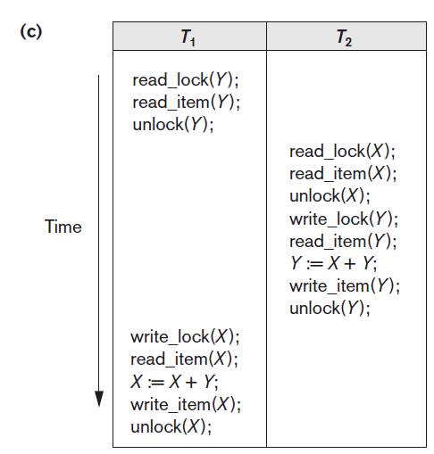
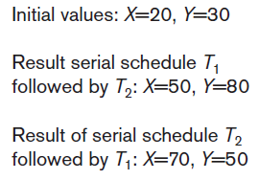
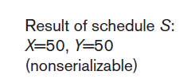
Locking Techniques for Concurrency Control
Simple Locking
Simple locking does not guarantee serializability.

Slide 28
Two-Phase Locking Techniques for Concurrency Control
Guaranteeing Serializability by Two-Phase Locking
A transaction is said to follow the two-phase locking (2PL) protocol if:
all locking operations (read_lock, write_lock) are done before the first unlock operation in the transaction.
Such a transaction can be divided into two phases:
expanding or growing phase,
In this phase, new locks on items can be acquired
but no lock can be released even if the data item is no more needed.
shrinking phase,
All existing locks can be released
and no new locks can be acquired.

Slide 29
Two-Phase Locking Techniques for Concurrency Control
Guaranteeing Serializability by Two-Phase Locking
Lock point:
The point at which locking ends and unlocking starts
This point helps in defining serializable schedules
Problems in Basic 2PL:
May limit the amount of concurrency between transactions
Unnecessary lock acquisition even if the item is not needed right now. i.e., early locking
This is the price for guaranteeing serializability without having to check the schedules them selves
Deadlocks might occur
cascading rollback is needed

Slide 30
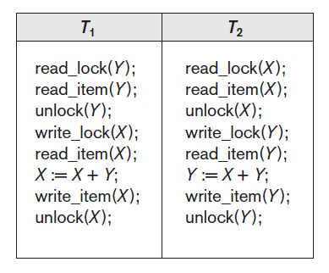
Two-Phase Locking Techniques for Concurrency Control
Guaranteeing Serializability by Two-Phase Locking
Transactions T1 and T2 violates the 2PL protocol because:
the write_lock(X) operation follows the unlock(Y) operation in T1,
Similarly, the write_lock(Y) operation follows the unlock(X) operation in T2.

Slide 31
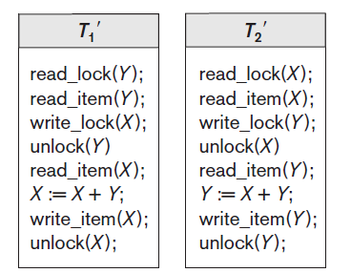
Two-Phase Locking Techniques for Concurrency Control
Guaranteeing Serializability by Two-Phase Locking
After enforcing 2PL, the transactions can be rewritten as T1′ and T2′.
Now, the schedule shown is not permitted for T1′ and T2′ because T1′ will issue its write_lock(X) before it unlocks item Y.
Consequently, when T2′ issues its read_lock(X), it is forced to wait until T1′ releases the lock by issuing an unlock (X) in the schedule.
However, this can lead to deadlock.

Slide 32
Two-Phase Locking Techniques for Concurrency Control
Guaranteeing Serializability by Two-Phase Locking
Problem in Basic 2PL:
As we have discussed earlier that 2PL may limit the amount of concurrency that can occur in a schedule because:
a transaction T may not be able to release an item X even though it is done with X because it has to acquire a lick for a data item Y
Or transaction T must lock the additional item Y before it needs it so that it can release X.

Slide 33
Two-Phase Locking Techniques for Concurrency Control
Basic, Conservative, Strict, and Rigorous Two-Phase Locking
There are number of variations of 2PL namely,
Basic 2PL (the one discussed in the preceding slides)
Conservative/static 2PL
Strict 2PL
Rigorous 2PL

Slide 34
Two-Phase Locking Techniques for Concurrency Control
Basic, Conservative, Strict, and Rigorous Two-Phase Locking
Conservative 2PL (or static 2PL):
requires a transaction to lock all the items it is going to access in future before the transaction begins execution,
by predeclaring its read-set and write-set.
Advantages:
Deadlock free
Problem:
Cascading roll back

Slide 35
Two-Phase Locking Techniques for Concurrency Control
Basic, Conservative, Strict, and Rigorous Two-Phase Locking
Strict 2PL:
a transaction T does not release any of its exclusive (write) locks until after it commits or aborts.
We have growing phase in which locks are acquired
Shrinking phase will realease only read locks , once the commit is done only then Write locks are unlocked.
Advantages:
No dirty read problem
Problem:
Can have Deadlock as locks are acquired in growing phase

Slide 36
Two-Phase Locking Techniques for Concurrency Control
Basic, Conservative, Strict, and Rigorous Two-Phase Locking
Rigorous 2PL:
A transaction T does not release any of its locks (exclusive or shared both) until after it commits or aborts.
Problem:
Can have Deadlock as locks are acquired in growing phase

Slide 37
Two-Phase Locking Techniques for Concurrency Control
Basic, Conservative, Strict, and Rigorous Two-Phase Locking
The difference between conservative and rigorous 2PL:
The former must lock all its items before it starts, so once the transaction starts it is in its shrinking phase; the latter does not unlock any of its items until after it terminates (by committing or aborting), so the transaction is in its expanding phase until it ends.
The use of locks can causes two additional problems: deadlock and starvation.

Slide 38
Two-Phase Locking Techniques for Concurrency Control
Dealing with Deadlock and Starvation
Deadlock: Occurs when each transaction T in a set of two or more transactions is waiting for some item that is locked by some other transaction T′ in the set.
Each transaction in the set is in a waiting queue, waiting for one of the other transactions in the set to release the lock on an item.

Slide 39
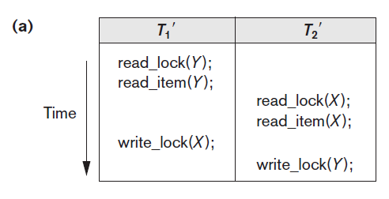
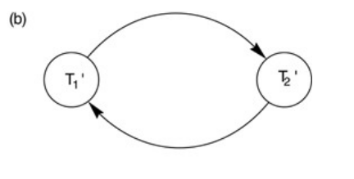
Two-Phase Locking Techniques for Concurrency Control
Dealing with Deadlock and Starvation
T1′ is in the waiting queue for X, which is locked by T2′, whereas T2′ is in the waiting queue for Y, which is locked by T1′.
Meanwhile, neither T1′ nor T2′ nor any other transaction can access items X and Y.

Slide 40
Two-Phase Locking Techniques for Concurrency Control
Dealing with Deadlock and Starvation
There are two approaches:
Deadlock prevention
Mostly used for real time systems
Where delays because of deadlocks are not appreciated
Deadlock detection & recovery
Used the chances of deadlock occurrence is minimum,
Its more likely a reactive approach in case of deadlock occurrence

Slide 41
2PL Techniques for Concurrency Control
Dealing with Deadlock and Starvation
Deadlock Prevention Protocols.
One deadlock prevention protocol,
which is used in conservative two-phase locking, requires that every transaction lock all the items it needs in advance —if any of the items cannot be obtained, none of the items are locked.
Obviously, this solution further limits concurrency.
A second protocol,
involves ordering all the items in the database and making sure that a transaction that needs several items will lock them according to that order.
This also limits concurrency
The third one is transaction timestamp TS(T′)
which is a unique identifier assigned to each transaction.
The timestamps are based on the order in which transactions are started; if transaction T1 starts before transaction T2, then TS(T1) < TS(T2).

Slide 42
Two-Phase Locking Techniques for Concurrency Control
Dealing with Deadlock and Starvation
Deadlock Prevention Protocols.
Two schemes that uses timestamps to prevent deadlock are:
wait-die
wound-wait.

Slide 43
Two-Phase Locking Techniques for Concurrency Control
Dealing with Deadlock and Starvation
Deadlock Prevention Protocols.
Wait-die:
If (TS(Ti) < TS(Tj)),
then wait(T_{i});
Else,
Die(T_{i})
and restart it later with the same timestamp.
Younger transactions never wait for older ones; they are rolled back instead.
A transaction may die several times before acquiring needed data item

Slide 44
Two-Phase Locking Techniques for Concurrency Control
Dealing with Deadlock and Starvation
Deadlock Prevention Protocols.
Wound-wait:
If (TS(Ti) < TS(Tj)),
abort Tj (Ti wounds Tj)
and restart it later with the same timestamp;
Else
Ti is allowed to wait.
Older transaction wounds (forces rollback) of younger transaction instead of waiting for it.
Younger transactions may wait for older ones.
May be fewer rollbacks than wait-die scheme.

Slide 45
Two-Phase Locking Techniques for Concurrency Control
Dealing with Deadlock and Starvation
Deadlock Prevention Protocols.
Both schemes end up aborting the younger of the two transactions that may be involved in a deadlock.
Both techniques may cause some transactions to be aborted and restarted needlessly, even though those transactions may never actually cause a deadlock.

Slide 46
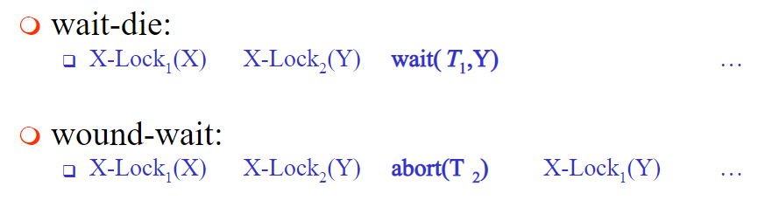
Two-Phase Locking Techniques for Concurrency Control
Dealing with Deadlock and Starvation
Deadlock Prevention Protocols.
T₁ (TS=10) | T₂ (TS=20)
W(X)
 | W(Y)
W(Y)
 | W(X)

Slide 47
Two-Phase Locking Techniques for Concurrency Control
Dealing with Deadlock and Starvation
Deadlock Prevention Protocols.
Another set of protocols that prevent deadlock without using timestamps are:
No waiting
Cautious waiting

Slide 48
Two-Phase Locking Techniques for Concurrency Control
Dealing with Deadlock and Starvation
Deadlock Prevention Protocols.
No waiting Algorithm
if a transaction is unable to obtain a lock,
it is immediately aborted and then restarted after a certain time delay without checking whether a deadlock will occur or not.
No transaction ever waits, so no deadlock will occur.
Problem:
A transaction will repeatedly be aborted and restarted

Slide 49
Two-Phase Locking Techniques for Concurrency Control
Dealing with Deadlock and Starvation
Deadlock Prevention Protocols.
Cautious waiting algorithm:
This algo is Proposed to reduce the number of needless aborts/restarts.
Transaction Ti tries to lock an item X
but is not able to do so because,
X is locked by some other transaction Tj with a conflicting lock.
Cautious waiting rule is :
If Tj is not blocked (not waiting for some other locked item),
then Ti is blocked
and allowed to wait;
otherwise
abort Ti.

Slide 50
Two-Phase Locking Techniques for Concurrency Control
Dealing with Deadlock and Starvation
Deadlock Prevention Protocols.
Cautious waiting algorithm:
Advantage:
No transaction is evr waiting for a blocked transaction
Hence, Deadlock free

Slide 51
Two-Phase Locking Techniques for Concurrency Control
Dealing with Deadlock and Starvation
Deadlock Prevention Protocols.
Deadlock Detection:
The system checks if a state of deadlock actually exists.
We can use this scheme :
If we know that different transactions will rarely access the same items at the same time.
if the transactions are short and each transaction locks only a few items.

Slide 52
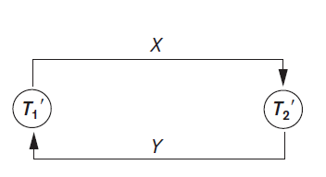
Two-Phase Locking Techniques for Concurrency Control
Dealing with Deadlock and Starvation
Deadlock Prevention Protocols.
Way to detect a state of deadlock is for the system to construct and maintain a wait-for graph.

Slide 53
Two-Phase Locking Techniques for Concurrency Control
Dealing with Deadlock and Starvation
Deadlock Prevention Protocols.
How to create a wait-for graph
One node is created in the wait-for graph for each transaction that is currently executing.
Whenever a transaction Ti is waiting to lock an item X that is currently locked by a transaction Tj,
a directed edge (Ti → Tj) is created
When Tj releases the lock(s) on the items that Ti was waiting for,
the (Ti → Tj) is dropped from the wait-for graph.
We have a state of deadlock if and only if the wait-for graph has a cycle.
When to Check for a cycle:
every time an edge is added to the wait for graph,
but this may cause excessive overhead.

Slide 54
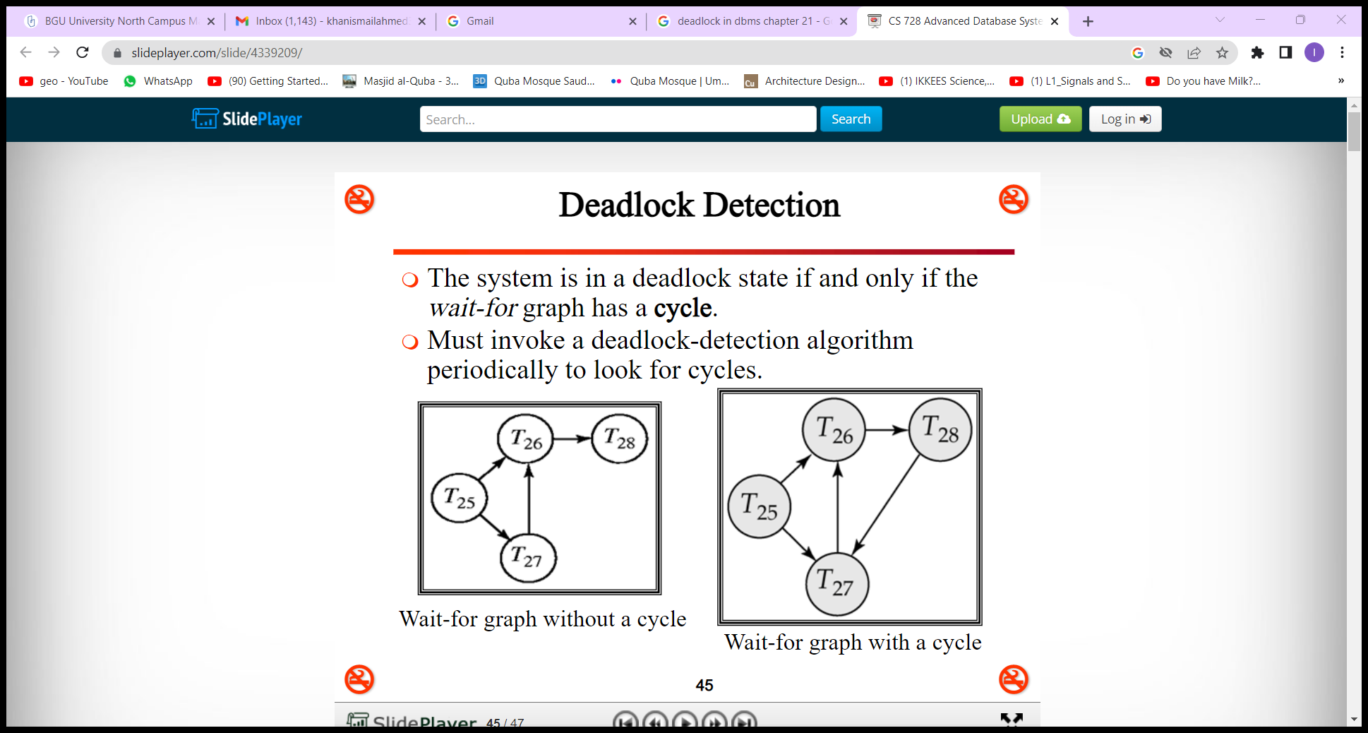
Two-Phase Locking Techniques for Concurrency Control
Dealing with Deadlock and Starvation
Deadlock Prevention Protocols.
wait-for graph.

Slide 55
Two-Phase Locking Techniques for Concurrency Control
Dealing with Deadlock and Starvation
Deadlock Prevention Protocols.
If the system is in a state of deadlock,
some of the transactions causing the deadlock must be aborted.
Choosing which transactions to abort is known as victim selection.
The algorithm for victim selection should:
avoid;
selecting transactions that have been running for a long time
and that have performed many updates, (older transactions)
Select;
transactions that have not made many changes (younger transactions).

Slide 56
Two-Phase Locking Techniques for Concurrency Control
Dealing with Deadlock and Starvation
Timeouts.
Another way to Deal with deadlock is the use of timeouts.
How it works?
If a transaction waits for a period > the system-defined timeout period,
the system assumes that the transaction may be deadlocked
and aborts it regardless of whether a deadlock actually exists.
Advantage:
Practical approach as Low overhead and simple

Slide 57
Two-Phase Locking Techniques for Concurrency Control
Dealing with Deadlock and Starvation
Starvation.
Problem that may occur when we use locking is starvation,
which occurs when a transaction cannot proceed for an indefinite period
while other transactions in the system continue normally.

Slide 58
Two-Phase Locking Techniques for Concurrency Control
Dealing with Deadlock and Starvation
Starvation.
Why it occurs?
The waiting scheme for locked items is unfair in that it gives priority to some transactions over others.
Starvation can also occur because of victim selection if the algorithm selects the same transaction as victim repeatedly, thus causing it to abort and never finish execution.
Solutions:
One solution for starvation is to have a fair waiting scheme, such as using a first-come-first-served queue.
Another scheme allows some transactions to have priority over others but increases the priority of a transaction the longer it waits, until it eventually gets the highest priority.

Slide 59
Concurrency Control Based on Timestamp Ordering
Timestamps
Unique Id created by DBMS to identify a transaction
Values are assigned in the sequence in which the transactions are submitted to the system
So, a timestamp could be the transaction start time.
Timestamp generation:
Logical counter:
Use a counter & increment every time whenever a transactions starts.
Reset the counter to 0 when system is not executing transactions for a period of time
System clock value:
Use system Date/time to be assigned to transactions. Just make sure that two transactions cannot be submitted at the same clock tick.
Denoted as TS(T₁) i.e., Timestamp of transaction T₁
Advantages:
No locking & hence, no deadlocks

Slide 60
Concurrency Control Based on Timestamp Ordering
The Timestamp Ordering Algorithm for Concurrency Control
Timestamp ordering (TO):
Done as per the transactions arrival time
Equivalent serial schedule permitted has the transactions in order of their timestamp values.
For example,
If T₁ starts at 1ns, T₂ starts at 2ns and T₃ start at 3ns
Equivalent serial schedule will be T₁ T₂ T₃
Serializability will be checked w.r.t this equivalent serial schedules.

Slide 61
Concurrency Control Based on Timestamp Ordering
The Timestamp Ordering Algorithm for Concurrency Control
with each database item X, 2 timestamp (TS) values are associated:
read_TS(X)
The read timestamp of item X is the largest timestamp among all the timestamps of transactions that have successfully read item X—that is, read_TS(X) = TS(T),
where T is the youngest transaction that has read X successfully.
Youngest/latest transactions have largest TS value
write_TS(X)
The write timestamp of item X is the largest of all the timestamps of transactions that have successfully written item X—that is, write_TS(X) = TS(T)
where T is the youngest transaction that has write X successfully.
Youngest/latest transactions have largest TS value

Slide 62
Concurrency Control Based on Timestamp Ordering
The Timestamp Ordering Algorithm for Concurrency Control
Basic Timestamp Ordering (TO) Protocol
Whenever some transaction T tries to issue a read_item(X) or a write_item(X) operation,
the basic TO algorithm compares the timestamp of T with read_TS(X) and write_TS(X)
to ensure that the timestamp order of transaction execution is not violated.
If this order is violated,
then transaction T is aborted
and resubmitted to the system as a new transaction with a new timestamp.
If T is aborted and rolled back, any transaction T1 that may have used a value written by T must also be rolled back.
Similarly, any transaction T2 that may have used a value written by T1 must also be rolled back, and so on.
Problem:
cascading rollback is one of the problems associated with basic TO.

Slide 63
Concurrency Control Based on Timestamp Ordering
The Timestamp Ordering Algorithm for Concurrency Control
Basic Timestamp Ordering (TO).
RULE 1:
Whenever a transaction T issues a write_item(X) operation, the following check is performed:
If read_TS(X) > TS(T) or if write_TS(X) > TS(T),
then abort and roll back T and reject the operation.
This should be done because some younger transaction with a timestamp greater than TS(T) has already read or written the value of item X before T had a chance to write X, thus violating the timestamp ordering.
Else
execute the write_item(X) operation of T
and set write_TS(X) to TS(T).

Slide 64
Concurrency Control Based on Timestamp Ordering
The Timestamp Ordering Algorithm for Concurrency Control
Basic Timestamp Ordering (TO).
RULE 2:
Whenever a transaction T issues a read_item(X) operation, the following check is performed:
If write_TS(X) > TS(T),
then abort and roll back T and reject the operation. This should be done because some younger transaction with timestamp greater than TS(T) has already written the value of item X before T had a chance to read X.
If write_TS(X) < TS(T),
then execute the read_item(X) operation of T
and set read_TS(X) to the larger of TS(T) and the current read_TS(X).

Slide 65
Concurrency Control Based on Timestamp Ordering
The Timestamp Ordering Algorithm for Concurrency Control
Basic Timestamp Ordering (TO).
RULE 1 & 2 :
Ti issues a Read(X):
If write_TS(X) > TS(Ti),
Abort & rollback Ti
Else,
Do R(X)
Read_TS(X)=Max(Read_TS(X),TS(Ti))
Ti issues a Write(X):
If Read_TS(X) > TS(T),
Abort & Rollback Ti
Else if Write_TS(X) >TS(Ti),
Abort & Rollback Ti
Else
Do W(X)
Write_TS(x)=TS(Ti)

Slide 66
EXAMPLE
T1(100) | T2(200) | T3(300)
R(A)
 | R(B)
W(C)
 |  | R(B)
R(C)
 | W(B)
 |  | W(A)
 | A | B | C
RTS(Ti) | 0 | 0 | 0
WTS(Ti) | 0 | 0 | 0
 | A | B | C
RTS(Ti) | 0 100 | 0 200 300 | 0 100
WTS(Ti) | 0 300 | 0 | 0 100
WHICH TRANSACTION WILL BE ROLLED BACK? T2
Notes:
WHICH TRANSACTION WILL BE ROLLED BACK?

Slide 67
Concurrency Control Based on Timestamp Ordering
The Timestamp Ordering Algorithm for Concurrency Control
Basic Timestamp Ordering (TO).
Advantages:
Whenever the basic TO algorithm detects two conflicting operations that occur in the incorrect order,
it rejects the later of the two operations by aborting the transaction that issued it.
The schedules produced by basic TO are hence guaranteed to be conflict serializable.

Slide 68
Concurrency Control Based on Timestamp Ordering
The Timestamp Ordering Algorithm for Concurrency Control
Thomas’s Write Rule.
A modification of the basic TO algorithm, known as Thomas’s write rule, does not enforce conflict serializability, but it rejects fewer write operations by modifying the checks for the write_item(X) operation as follows:
If write_TS(X) > TS(T), then do not execute the write operation but continue processing. This is because some transaction with timestamp greater than TS(T)—and hence after T in the timestamp ordering—has already written the value of X. Thus, we must ignore the write_item(X) operation of T because it is already outdated and obsolete.
Execute the write_item(X) operation of T and set write_TS(X) to TS(T).

Slide 69
Concurrency Control Based on Timestamp Ordering
The Timestamp Ordering Algorithm for Concurrency Control
Strict Timestamp Ordering (TO).
A variation of basic TO called strict TO ensures that the schedules are both strict (for easy recoverability) and (conflict) serializable.
In this variation, a transaction T issues a read_item(X) or write_item(X) such that TS(T) > write_TS(X) has its read or write operation delayed until the transaction T′ that wrote the value of X (hence TS(T′) = write_TS(X)) has committed or aborted.

